Slide 1
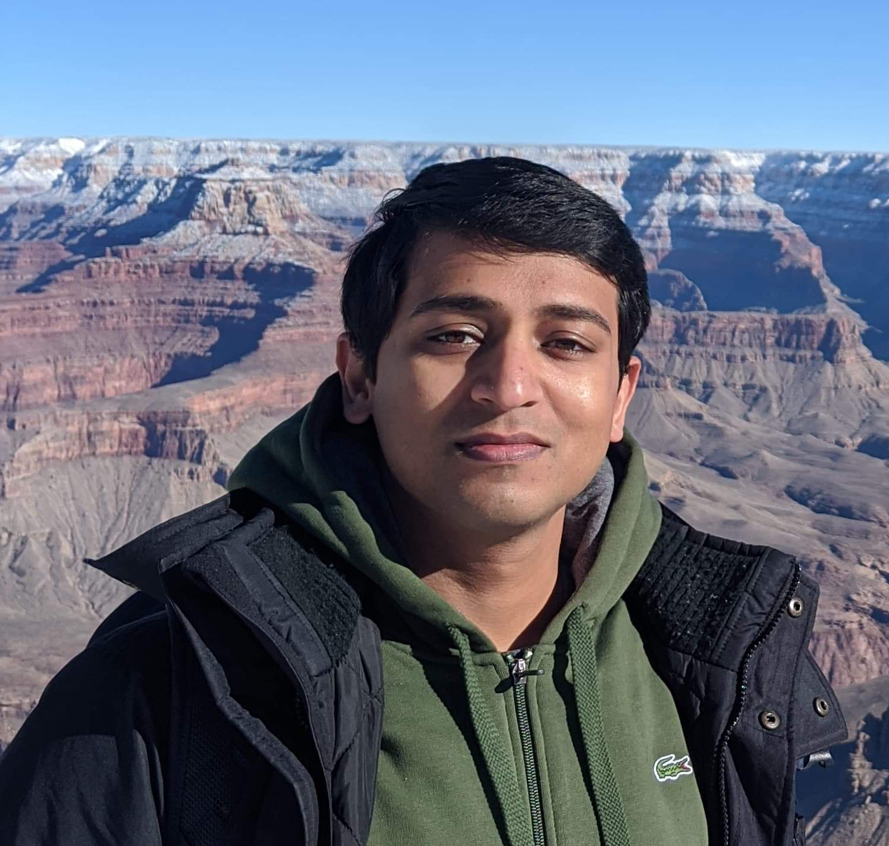
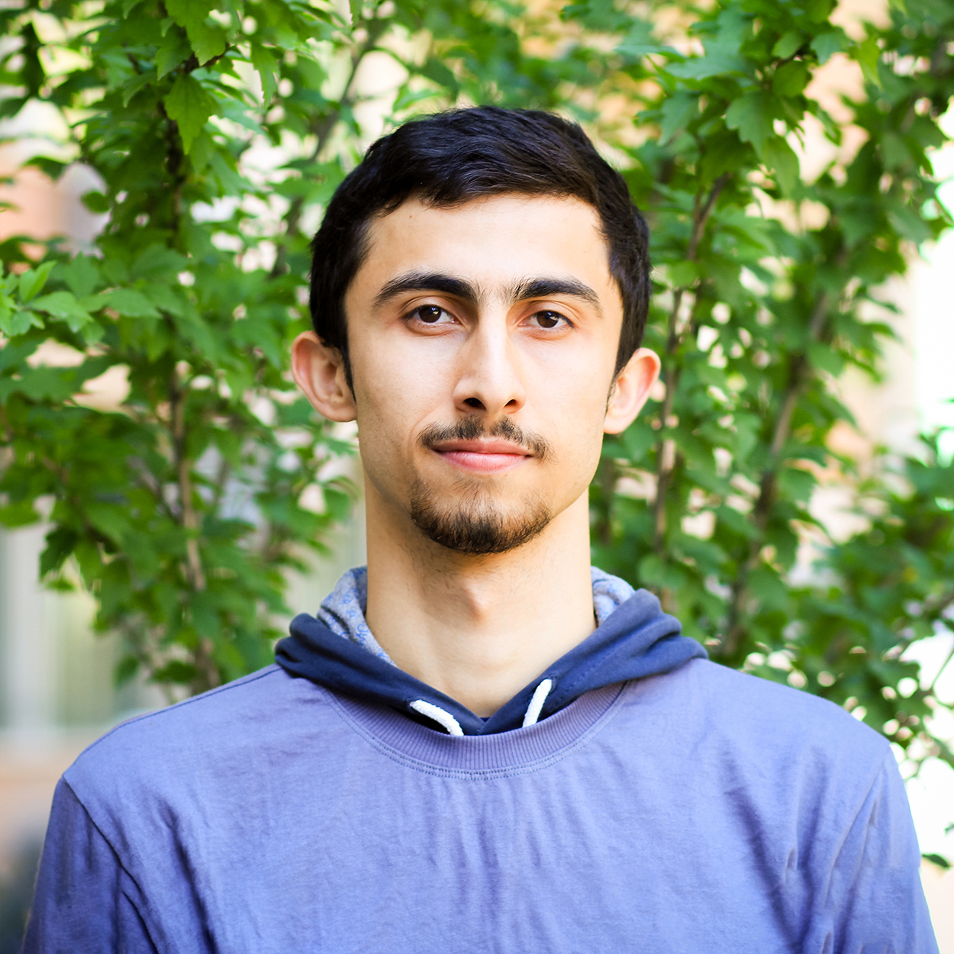
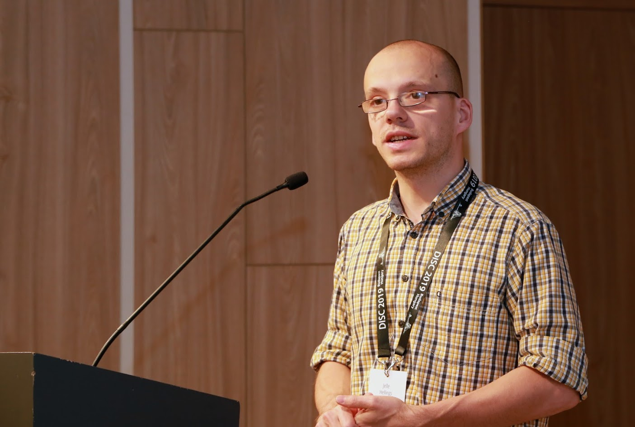
ResilientDB: Global Scale Resilient Blockchain Fabric
Suyash Gupta
Sajjad Rahnama
Jelle Hellings
Mohammad Sadoghi
Exploratory Systems Lab
University of California Davis

Slide 2
Blockchain Applications
Cryptocurrencies
Project Tracking
Waste
Management
Energy Trading
and Management
Healthcare

Slide 3
At the core of any Blockchain application is a Byzantine Fault-Tolerant (BFT) consensus protocol.
OK
OK
Order Txn
OK

Slide 4
Permissionless
vs.
Permissioned

Slide 5
Permissionless Blockchains
Cryptocurrencies: Bitcoin & Ethereum

Slide 6
Permissionless Blockchains
Open Access: Anyone can participate.
Identities of the replicas are unknown.

Slide 7
Permissionless Blockchains
Require computing complex hashes.
Wastage of Energy

Slide 8
Permissioned Blockchains
Identities known a priori.

Slide 9
Permissioned Blockchains
Applications: Blockchain Databases

Slide 10
Permissioned Blockchains
Employ traditional BFT consensus:
PBFT, Zyzzyva, SBFT…

Slide 11
Permissioned Blockchains
Computationally cheap
High Communication → Low Scalability

Slide 12
Challenges For Geo-Scale Blockchains
High!
Low!
Blockchain expects decentralization → Replicas maybe geo-distributed

Slide 13
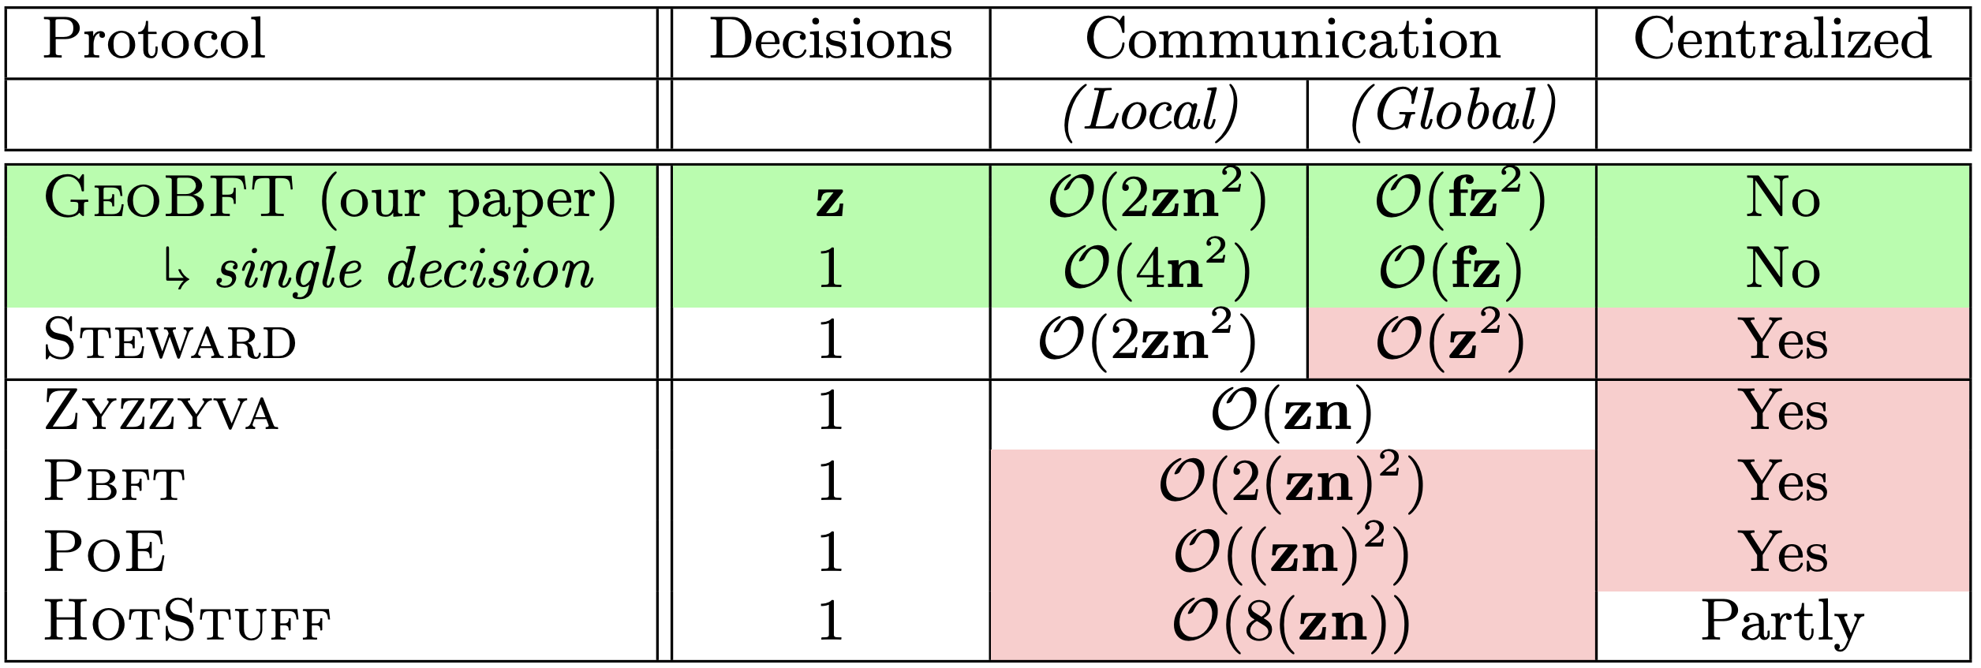
Limitations of Existing Consensus Protocols
Normal-case metrics for a system with z clusters, each with n replicas of which at most f , n > 3f , are Byzantine

Slide 14
GeoBFT Protocol
Local Replication
Inter-cluster Sharing
Ordering and Execution
Each cluster runs PBFT to select, locally replicate, and certify a client request.
Primary at each cluster shares the certified client request with other clusters.
Order the certified requests, execute them, and inform local clients.
Topology-aware protocol.
Parallel consensus at each cluster.
Low inter-cluster communication overheads.

Slide 15
Client
T₁
P_{C1}
Local PBFT Consensus on T₁
R_{1,1}
Cluster 1
C₁
R_{1,2}
R_{1,3}
Client
T₂
P_{C2}
Local PBFT Consensus on T₂
Cluster 2
C₂
R_{2,1}
R_{2,2}
R_{2,3}
Local Request
Local Replication
Global
Sharing
Local
Sharing
Reply

Slide 16
Local Replication
GeoBFT employs PBFT for local replication.
Tolerates up to f failure out of 3f+1 replicas
Three phases of which two require quadratic communication complexity.
Safety is always guaranteed and Liveness is guaranteed in periods of partial synchrony.
View-Change protocol for replacing malicious primary

Slide 17
PBFT Civil Execution
Client
T
Primary
Construct certificates that include T and n-f Commit messages.
Replica 1
Replica 2
Byzantine
Replica
Client
Request
Pre-Prepare
Prepare
Commit

Slide 18
Inter-Cluster Sharing
P_{C1}
P_{C2}
R_{2,1}
R_{2,2}
R_{2,3}
Global Phase
Local Phase
The Primary P_{C1} sends a certificate that includes the client request and commit messages from n-f replicas of Cluster C₁ .

Slide 19
Ordering and Execution
GeoBFT orders requests deterministically.
For i < j, requests of Cluster C_{i} are executed before requests of cluster C_{j}.
For example: requests of C₁ are executed before C₂ .

Slide 20
Implementation on ResilientDB
Network
Network
REPLICA
Client
Requests
Batching
Prepare & Commit
messages
Input
Output
Message from
Clients and Replicas
Message to
Replicas or Clients
Worker
Execute
Certificates
from other clusters
Certify
ResilientDB associates a multi-threaded deep-pipelined architecture with each replica.
ResilientDB is open-sourced at https://resilientdb.com/

Slide 21
Ledger (Blockchain) Management
i^{th} block in the ledger contains the i^{th} executed request.
In each round of GeoBFT, each replica executes z requests, each belonging to a different cluster C_{i} , 1 <= i <= z.
Hence, in each round, each replica creates z blocks.
To ensure immutability, each block includes both client requests and exchanged certificates.

Slide 22
Evaluation on ResilientDB
Google cloud used for deploying replicas and clients.
Each replica used 8-core Intel Skylake CPUs and had access to 16 GB memory.
Total 160K clients deployed on eight 4-core machines.
Workload provided by Yahoo Cloud Serving Benchmark (YCSB).
Replicas deployed across six different regions: Oregon, Iowa, Montreal, Belgium, Taiwan and Sydney.
Primaries for centralized protocol placed at Oregon (highest bandwidth).

Slide 23
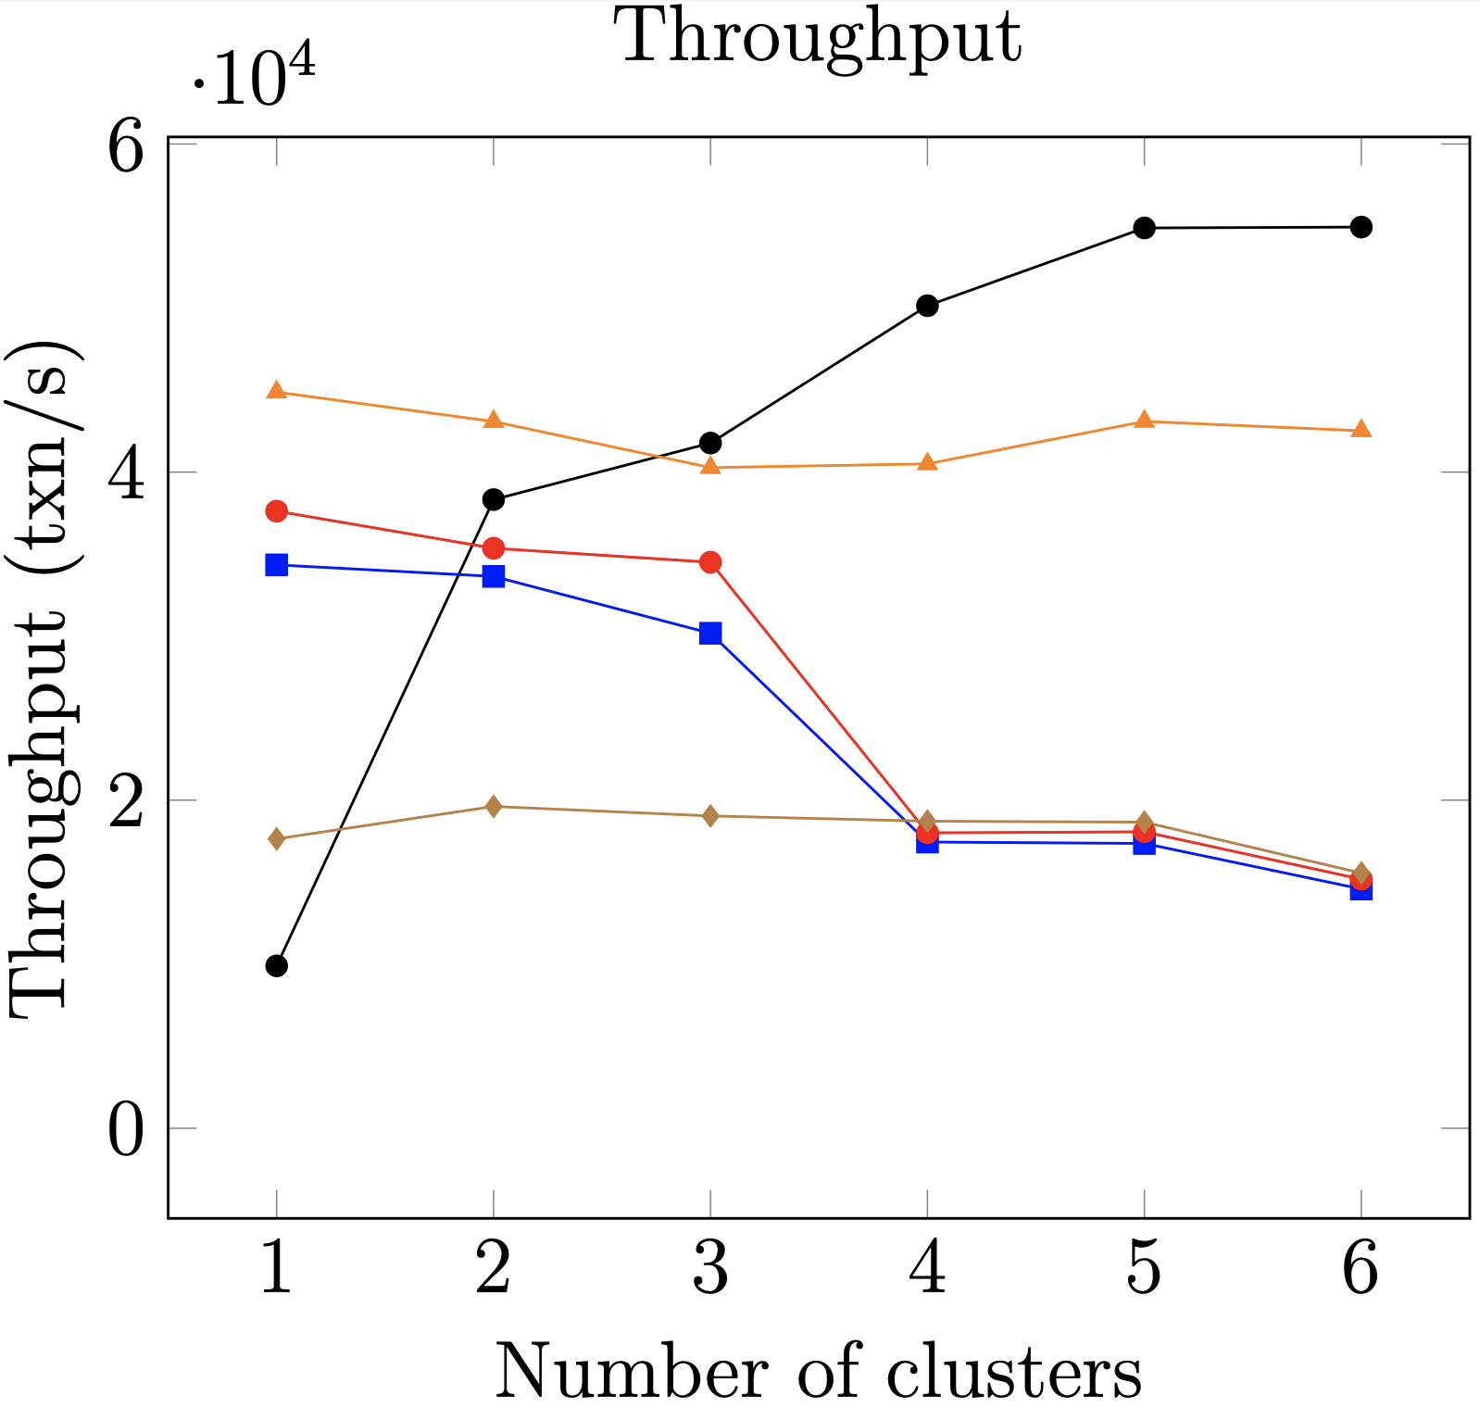
Scalability
1.3x
3.1x
Total replicas = 60

Slide 24
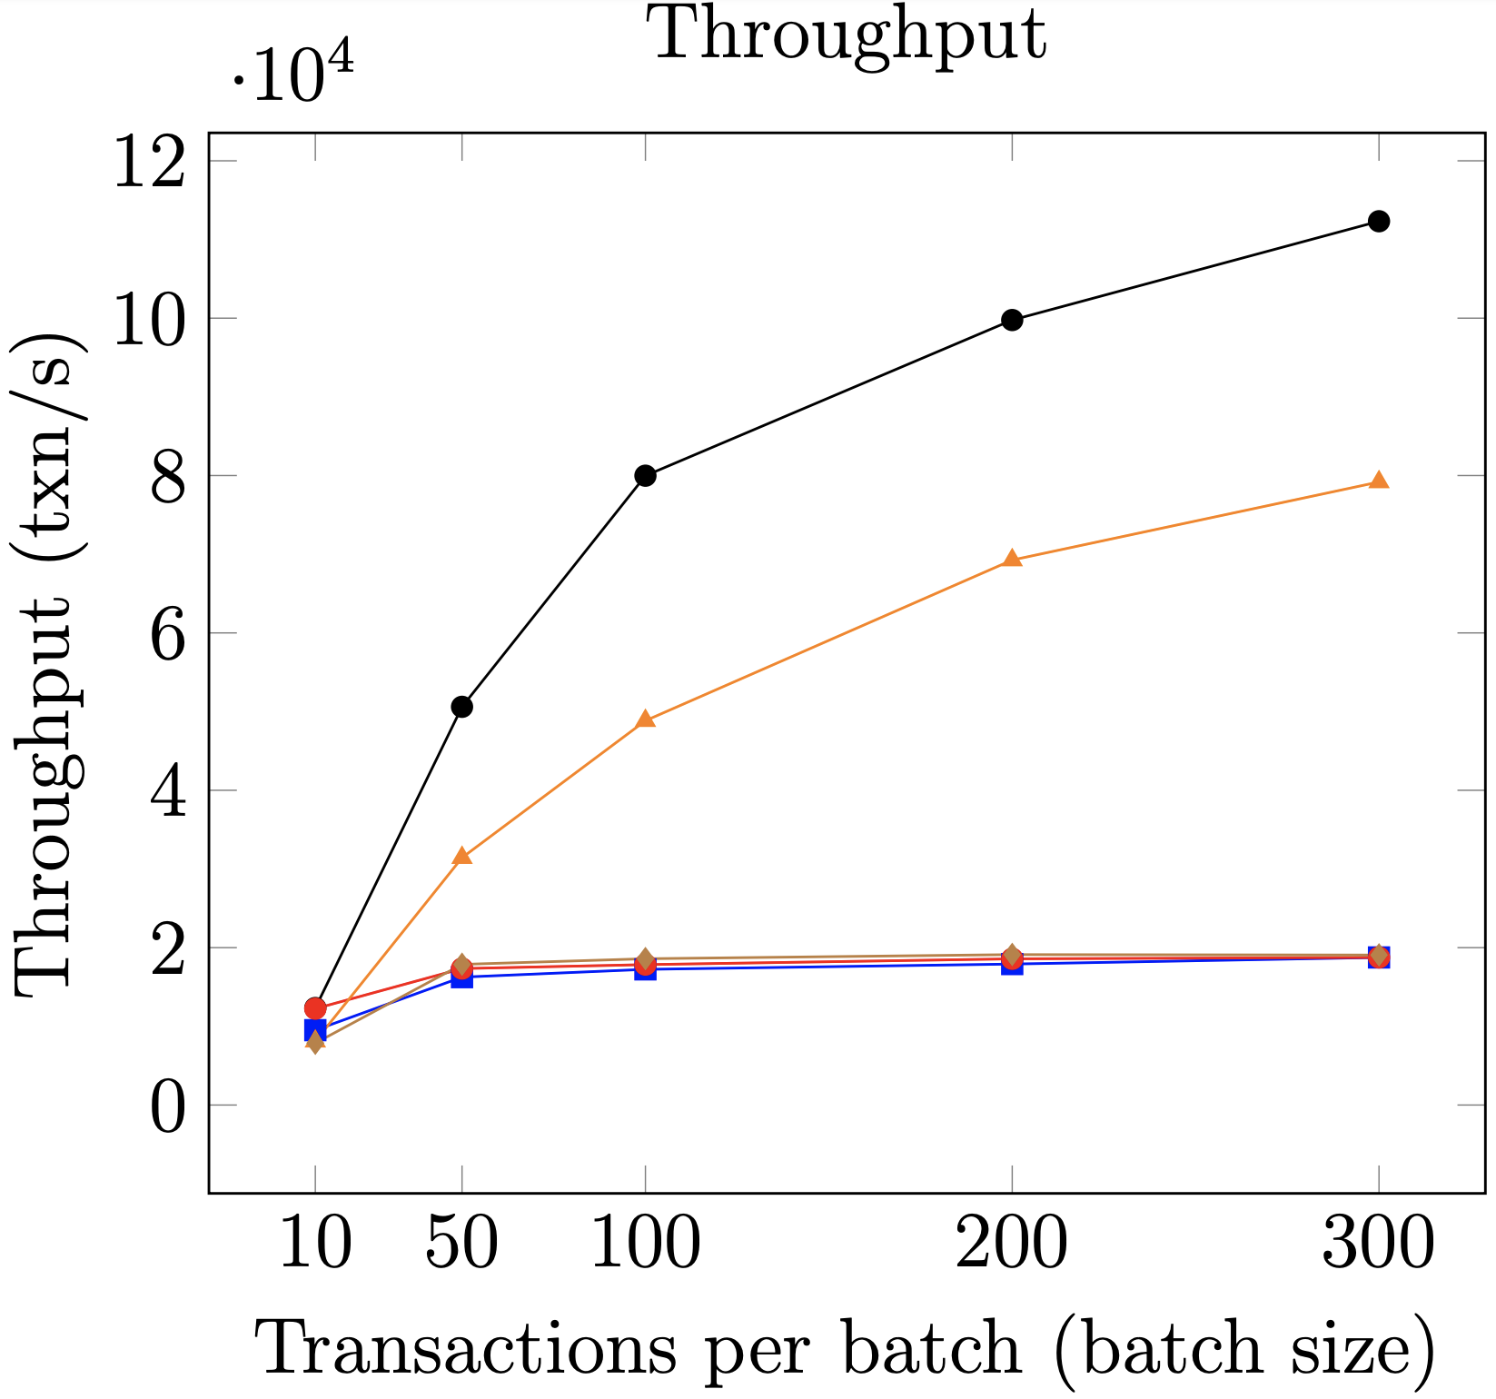
1.6x
6x
Batching
4 clusters and 7 replicas per cluster

Slide 25
Conclusions and Final Remarks
For achieving faster local replication, GeoBFT can employ other efficient BFT protocols, such as PoE.
Modern cryptographic techniques such as Threshold signatures can be used in place of sending n-f Commit messages.
If a cluster does not have a request, it can send “no-op” messages.
GeoBFT optimizes consensus by reducing global communication costs.
Parallel local replication helps to increase system throughput.

Slide 26
References
S. Gupta, S. Rahnama, J. Hellings, and M. Sadoghi. ResilientDB: Global Scale Resilient Blockchain Fabric. Proc. VLDB Endow., 13(6):868–883, Feb. 2020.
Miguel Castro and Barbara Liskov. Practical byzantine fault tolerance. In Proceedings of the Third Symposium on Operating Systems Design and Implementation, pages 173–186. USENIX Association, 1999.
Miguel Castro and Barbara Liskov. Practical byzantine fault tolerance and proactive recovery. ACM Transactions on Computer Systems, 20(4):398–461, 2002. doi:10.1145/571637.571640.
M. Yin, D. Malkhi, M. K. Reiter, G. G. Gueta, and I. Abraham. HotStuff: BFT consensus with linearity and responsiveness. In Proceedings of the 2019 ACM Symposium on Principles of Distributed Computing, PODC, pages 347–356. ACM, 2019.
R. Kotla, L. Alvisi, M. Dahlin, A. Clement, and E. Wong. Zyzzyva: Speculative byzantine fault tolerance. In Proceedings of Twenty-first ACM SIGOPS Symposium on Operating Systems Principles, SOSP, pages 45–58. ACM, 2007.
Yair Amir, Claudiu Danilov, Danny Dolev, Jonathan Kirsch, John Lane, Cristina Nita-Rotaru, Josh Olsen, and David Zage. Steward: Scaling byzantine fault-tolerant replication to wide area networks. IEEE Transactions on Dependable and Secure Computing, 7(1):80–93, 2010. doi:10.1109/TDSC.2008.53.
S. Gupta, J. Hellings, S. Rahnama, and M. Sadoghi, Proof-of-Execution: Reaching Consensus through Fault-Tolerant Speculation, CoRR, vol. abs/1911.00838, 2019.

